Slide 1
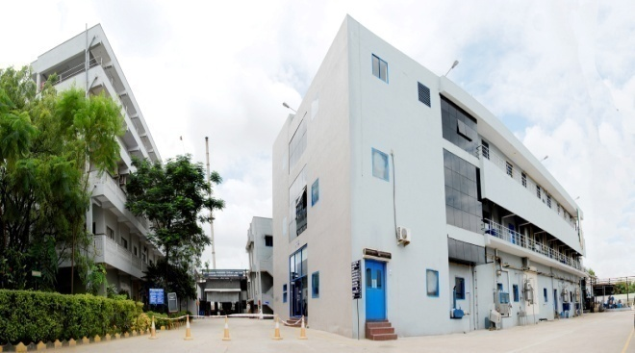
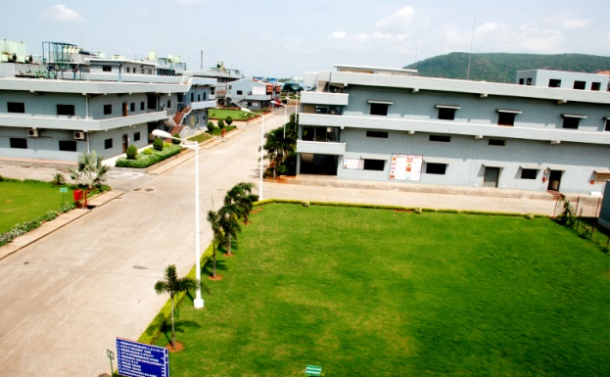
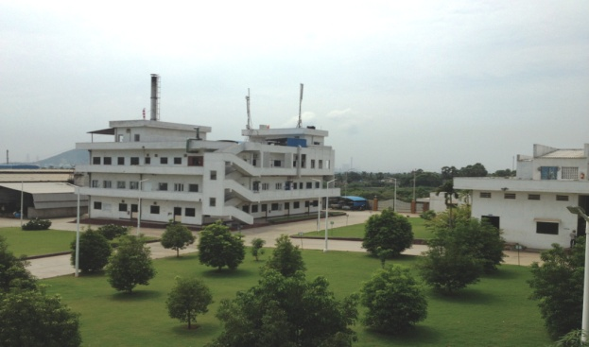
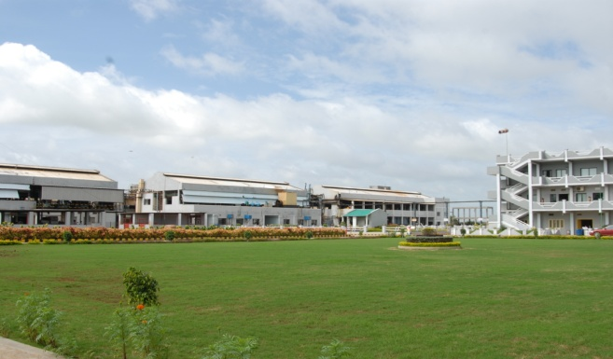
Vasudha Pharma Chem Limited
UNIT - I
UNIT - II
UNIT - III
SRCCL

Slide 2
History
A Public Limited company established in 1994 - 95 (closely held)
Commenced commercial production in the year 1996 - 97
Registered office : Vasudha Pharma Chem Limited
78 A, Vengalrao Nagar,
Hyderabad 500038, Telangana State, India
Tel : 0091- 40- 4476 3666 / 2371 1717
Fax : 0091- 40- 4476 3636 / 2381 1576
Email : vasudha@vasudhapharma.com
Website : www.vasudhapharma.com

Slide 3
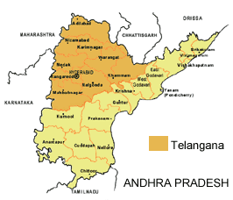
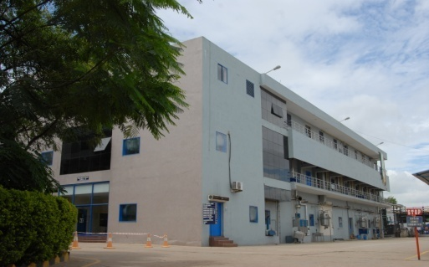
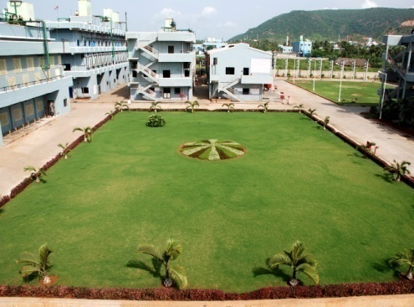
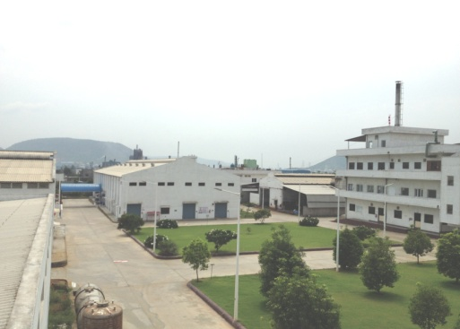
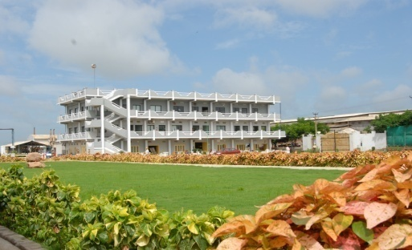
Production Facilities
Manufacturing Units:
Vasudha Pharma Chem Limited ….. Hyderabad … Unit I
Vasudha Pharma Chem Limited ….. Visakhapatnam … Unit II
Vasudha Pharma Chem Limited ….. Visakhapatnam … Unit III
Vasudha Pharma Chem Limited ….. Visakhapatnam … Unit IV
Shri Ram Chloro Chem Limited ….. Hyderabad … SRCCL
Unit I
Unit II
Unit III
SRCCL
SRCCS

Slide 4
Extent of area
Manufacturing Units: Area
Vasudha Pharma Chem Limited ….. Hyderabad … Unit I : 3.00 acres
Vasudha Pharma Chem Limited ….. Visakhapatnam … Unit II : 10.66 acres
Vasudha Pharma Chem Limited ….. Visakhapatnam … Unit III : 9.02 acres
Shri Ram Chloro Chem Limited ….. Hyderabad … SRCCL : 5.00 acres
Vasudha Pharma Chem Limited ….. Visakhapatnam … Unit IV : 3.32 acres
SRCCS

Slide 5
Turnover Growth - Corporate
Financial Year | INR in Millions
2011-12 | 4117
2012-13 | 4372
2013-14 | 4607
2014-15 | 5027
2015-16 | 5532
In Millions INR
Taking 1US$ yearly average = INR 66.25
Financial Year
Turnover in US$ = 84.22 millions
44 %
56 %

Slide 6
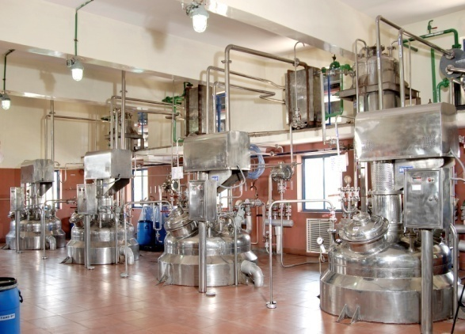
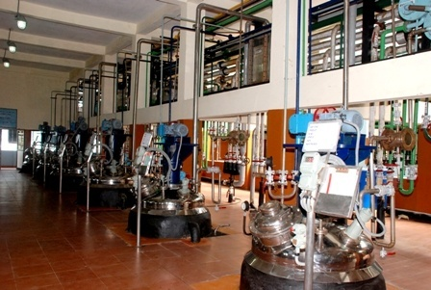
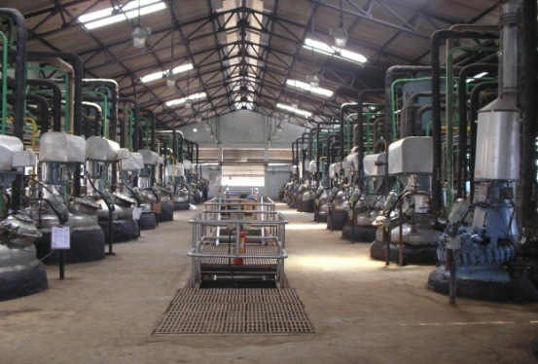
Nature of Business
APIs (Active Pharmaceutical Ingredients)
Intermediates of APIs
Specialized in Piperidone & Piperidine derivatives

Slide 7
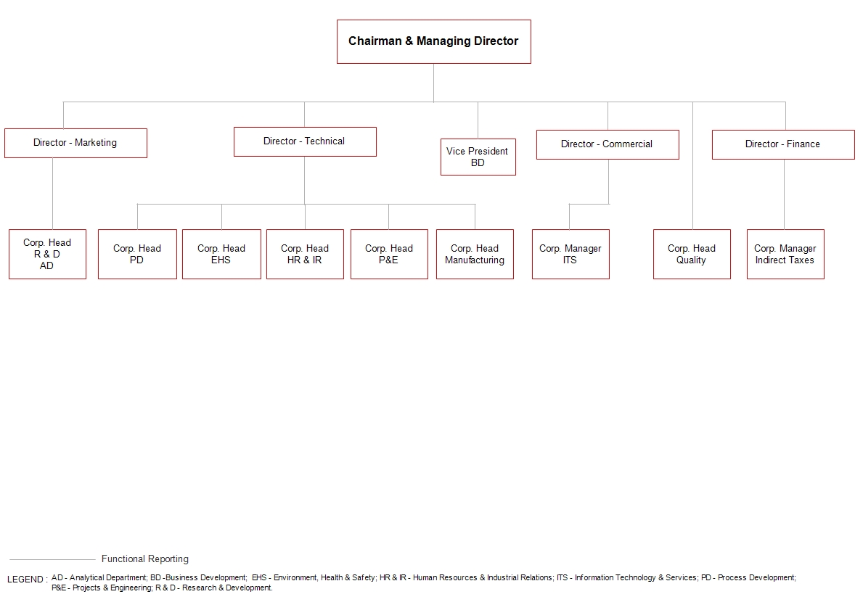
Corporate Organogram

Slide 8
List of key personnel
Name of the person | Key Responsibility | Qualification | Experience
Mr. M.V. Rama Raju | Chairman & Managing Director | M.Sc. | 40 + years
Mr. Ashok Mantena | Director - Technical | M.S. | 20+ years
Mr. Anand Mantena | Director - Commercial | M.B.A. | 18+ years
Mr. V.J.V.Raju | Director - Finance | M.Com, | 30+ years
Mr. Madhu M | Director - Marketing (Exports) | M.B.A. | 12+ years
Mr. Guru Prasad Nagalla | VP - Business Development | M.B.A. | 18+ years
Dr. G. Vamsi Krishna | Head - R & D | M.Sc., Ph. D. | 7+ years
Mr. K.S.B.S. Varma | Head - Corp. Quality | M.Sc. | 21+ years
Mr. K. Sridhar | Head - Corp. Process Development | M.Sc. | 17+ years
Mr. A. Jaya Surya | Head - Corp. Environment, Health and Safety | M.Sc. | 30+ years
Mr. K. Srihari Varma | Head - Projects and Engineering | B.Tech. | 15+ years

Slide 9
Regulatory strength : Corporate
A P I s | USFDA | SFDA (Saudi) | CEP | EDMF | Japan | Canada | Korea | China | Mexico | Taiwan | Others
Amitriptyline HCl |  |  |  |  |  |  |  |  |  |  | TGA Australia
Cyclobenzaprine HCl
Loratadine
Domperidone
Domperidone maleate
Cisapride monohydrate
Oxatomide
Ebastine |  |  |  |  |  |  |  |  |  |  | Sweden Italy Spain France Germany Belgium
Loperamide HCl |  |  |  |  |  |  |  |  |  |  | 1.Kazakhstan 2. HSA, 3.Ghana
Des loratadine |  |  |  |  |  |  |  |  |  |  | 1. Bulgaria 2. Ukraine
Cyproheptadine HCl |  |  |  |  |  |  |  |  |  |  | Iran
Pimozide
Ketrolac Tromethamine
Olmesartan Medoximil
Donepezil HCl
Pantoprazole |  |  |  |  |  |  |  |  |  |  | Kazakhstan
Fexofenadine HCl
Losartan potassium
Pregabalin

Slide 10
Key Customers
National Market
International Market
……..exporting to about 40 countries and many more customers around the world……

Slide 11
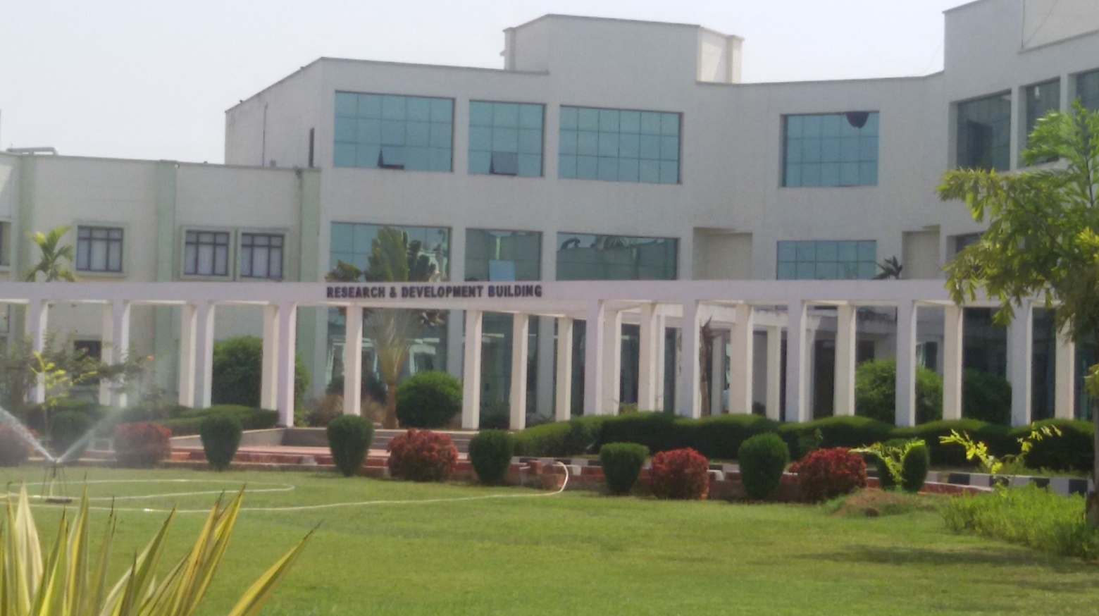
Research & Development Centre
Vasudha Pharma Chem Limited
Ramky Commercial Hub, Road No. 13
Jawaharlal Nehru Pharma City
Parawada, Visakhapatnam - 531 019
Andhra Pradesh., India

Slide 12
R & D objectives
Inventing novel synthetic routes for better yields and quality
Inventing new processes to meet custom synthesis
New product development
With Innovative technology and concern towards environment
VASUDHA PHARMA CHEM LIMITED
always looks forward for
MEETING THE WORLD’S REQUIREMENT

Slide 13
R & D activities
New products development.
Process development (cost / time cycle reduction).
Technology transfer and Scale up.
Support in DMFs preparation for regulatory filings.
Project wise impurities isolation & synthesis along with characterization reports.
AD activities
Analytical support to R&D.
New Analytical Methods Development.
Analytical Method Validations/Verifications.
Stability Testing.
Forced Degradations and Carryover Studies.
Support in DMFs preparation for regulatory filings.
Impurities isolation by Preparative HPLC.

Slide 14
Organogram : R & D
Head – R&D
Manager-1
Manager-2
Asst. Manager-1
Asst. Manager-2
Asst. Manager-3
Asst. Manager-4
Asst. Manager-5
Asst. Manager-6
Asst. Manager-7
Asst. Manager-8
Dy. Manager
Jr.Mgr / Sr.Exec /
Exec
Jr.Mgr / Sr.Exec /
Exec
Jr.Mgr / Sr.Exec /
Exec
Jr.Mgr / Sr.Exec /
Exec
Jr.Mgr / Sr.Exec /
Exec
Jr.Mgr / Sr.Exec /
Exec
Jr.Mgr / Sr.Exec /
Exec
Jr.Mgr / Sr.Exec /
Exec
Jr.Mgr / Sr.Exec /
Exec

Slide 15
Organogram : AD
Head - AD
Manager
Dy.Manager R&D Support
Asst.Manager-4 (AMVs/Regulatory studies)
Asst.Manager -5 (AMTs / Calib )
Asst.Manager -6 (Stability)
Jr.Mgr / Sr.Exec / Executives
Jr.Mgr / Sr.Exec / Executives
Jr.Mgr / Sr.Exec / Executives
Asst.Manager -1 (R&D Support)
Asst.Manager -2 (R&D Support)
Asst.Manager -3 (R&D Support)
Jr.Mgr / Sr.Exec / Executives
Jr.Mgr / Sr.Exec / Executives
Jr.Mgr / Sr.Exec / Executives

Slide 16
Employee strength: R & D and AD
Qualification | Full-time (Number) | Part-time (Number) | Proposed Recruitment of R&D manpower in next three years
Doctorate Degree | 2 | 1 | 7 (10)
Master’s Degree | 62 | - | 58 (120)
Graduates/Engineering Graduates | 3 | - | 0 (3)
Total | 67 | 1 | 65 (133)

Slide 17
List of equipment : R & D
S.No | Name of equipment | Qty | Remarks
1 | Fuming Hoods | 19
2 | Rota vapors | 10 | 7 to be received.
3 | Vacuum pumps | 8 | 6 to be received.
4 | Vacuum tray driers | 4
5 | Tray driers | 4
6 | Auto clave | 3
7 | Ice maker | 1 | To be received.
8 | Weighing Balance | 4 | 2 to be received.
9 | Mechanical stirrers | 60
10 | Water bath (Mantels) | 40

Slide 18
List of equipment : AD
S.No | Name of equipment | Qty in No’s | Remarks
1 | HPLCs | 15 | 10 to be received.
2 | Prep LC / Flash chromatography | 2 | 1 to be received.
3 | GCs | 3 | 1 to be received.
4 | HSGCs | 3 | 2 to be received.
5 | UV Vis Spectrophotometer | 1
6 | FTIR | 1 | 1 to be received
7 | Stability chambers | 3
8 | Photo stb chamber | 1
9 | Analytical balances | 4 | 2 to be received.
10 | KF Titrators | 2 | 1 to be received.
11 | MR apparatus | 2
12 | Potentiometer | 1 | To be received.
13 | pH meter | 2 | 1 to be received.
14 | Ovens | 3
15 | UV Cabinet | 2 | 2 to be received.
16 | Muffle furnace | 1 | To be received.
17 | Fuming Hood | 1

Slide 19
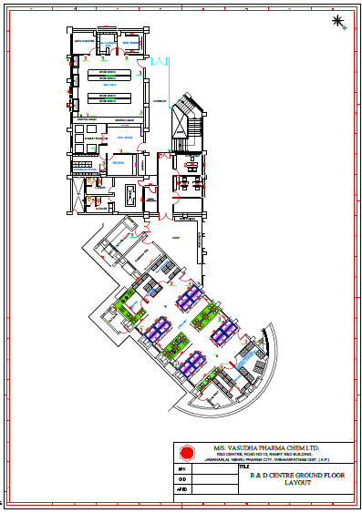
Layout : R & D

Slide 20
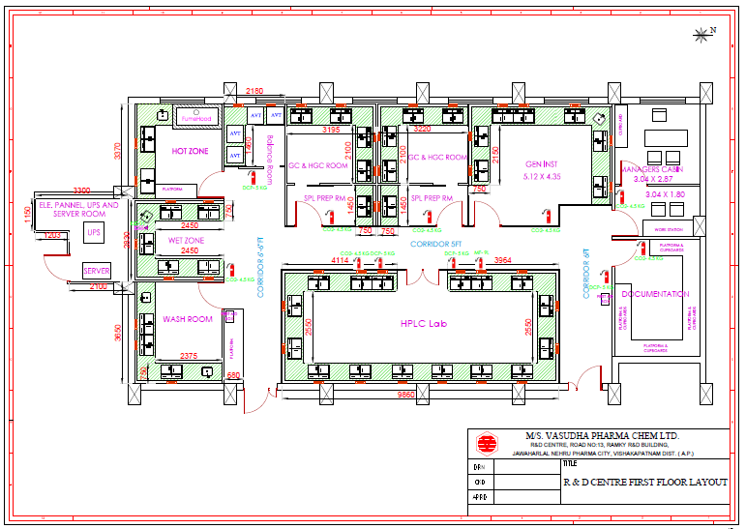
Layout : AD
Total Area of R&D Centre: 11043 sq.ft

Slide 21
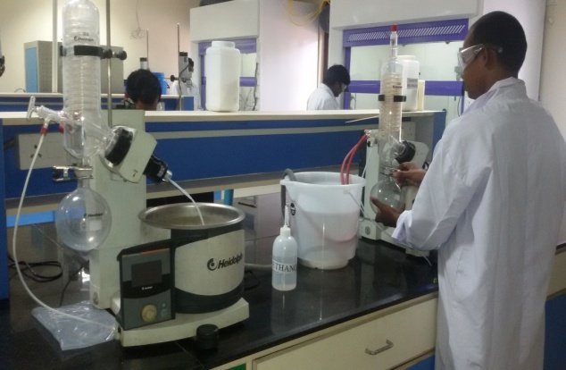
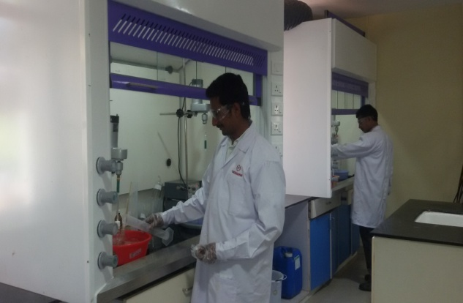
Chemistry Capabilities
Amidation
Addition reactions
N-Alkylations
Bromination
Column Chromatography for
multi-gram purifications
Chlorination
Condensation
Cyclization
De-carboxylations
Diazotization
Elimination reactions
Esterifation
Epoxidation
Grignard reactions

Slide 22
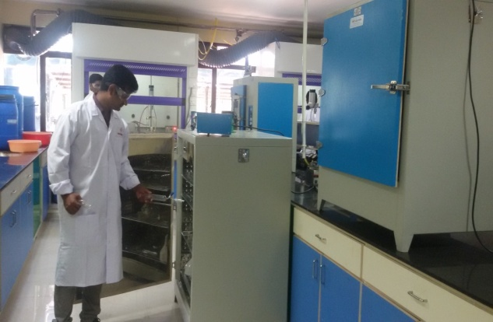
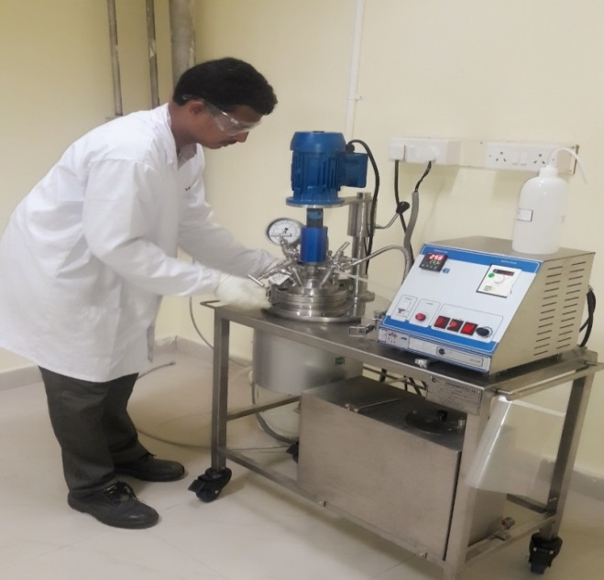
Chemistry Capabilities
Hydrolysis
Hydrogenation reactions
Hoff-man rearrangement
Low temperature reaction
Cryogenic reactions
Protection & de-protection
Oxidations
Reductions
Resolution
Racemizations.
Salt formation
Stereo selective and Chiral resolutions
Wittig reactions
Cyanation
Suzuki / Buchwald couplings
Peptide couplings
And all general reactions

Slide 23
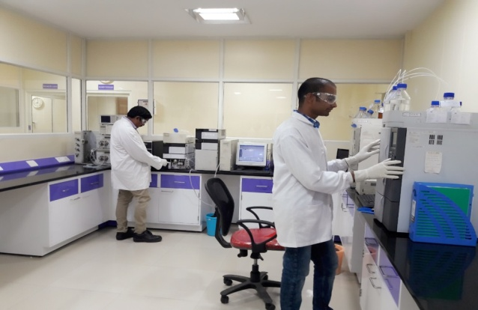
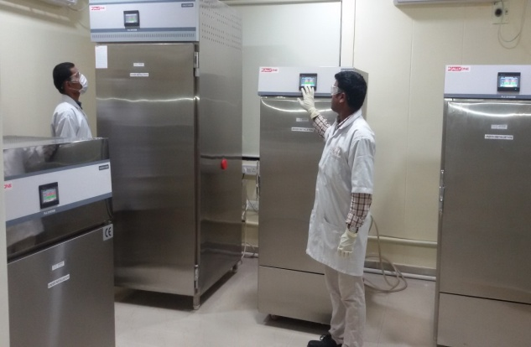
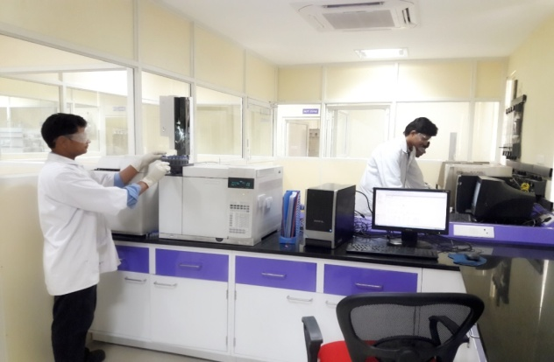
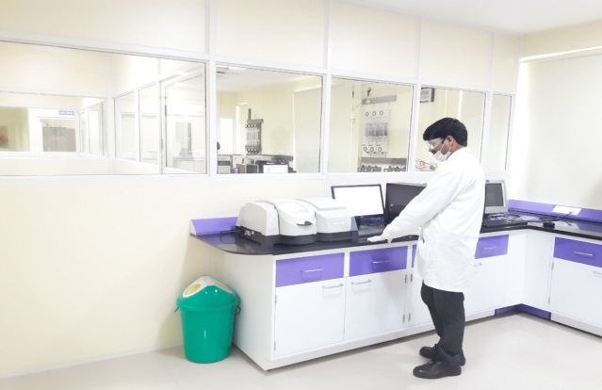
Analytical Capabilities
New Analytical Methods Development.
Analytical Method Validations/Verifications.
Stability Testing.
Forced Degradations and Carryover Studies.
Support in DMFs preparation for regulatory filings.
Impurities isolation by Preparative HPLC.

Slide 24
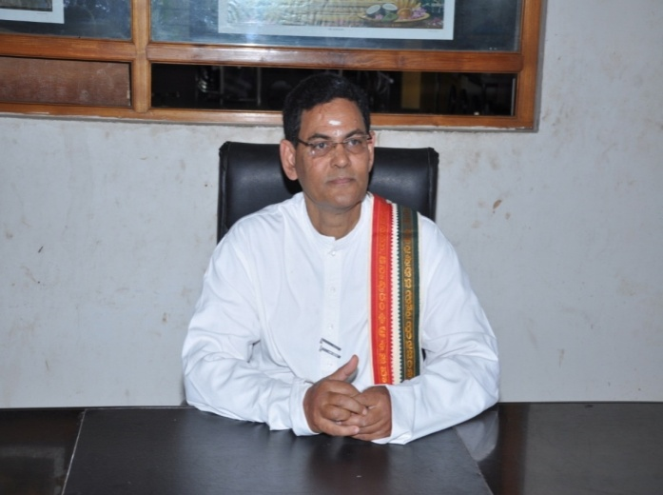
Vasudha Foundation
Vasudha Foundation
a charity organization, promoted in 2002 by
Mr. Mantena Venkata Rama Raju
his family members and friends,
focusing on social welfare activities
to uplift the underprivileged people.

Slide 25
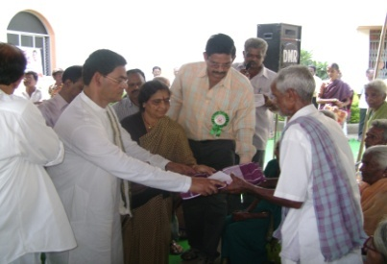
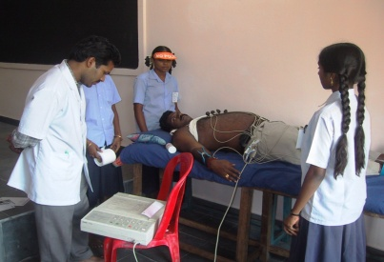
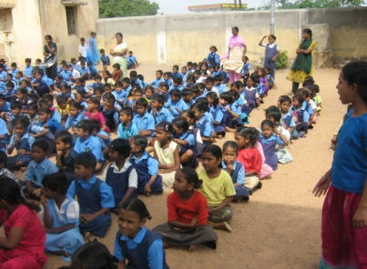
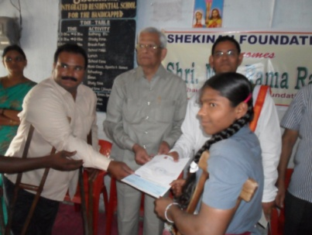
Vasudha Foundation
Carries out its services through the following programmes
Akshara (Education) :
Programme designed to extend helping hand to poor students persuing higher
education like engineering, medicine, post graduate courses etc
Aarogya (Health) :
Programme designed to provide financial assistance for medical treatment to
the poor and needy.
Aashraya (Shelter) :
Programme designed to address the problems faced by the senior citizens and
taking care of them during their sacred phase of Vruddhapya life.
Aadarana (Care and Rehabilitation) :
Programme designed to enable physically and mentally disabled people to face
the challenges in life and join the growth of the nation.
Akshaya (Relief during natural calamities) :
Programme designed to stand forefront to extend helping hand to the people
who are in crisis at the time of natural calamities and helping them to revert
back to their normal life.

Slide 26
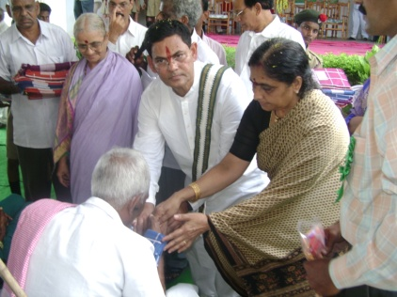
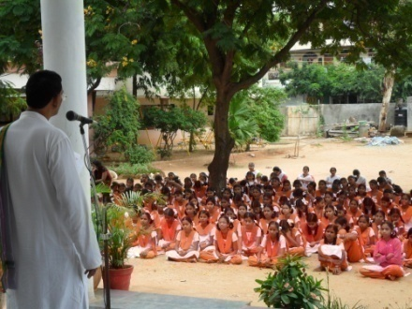
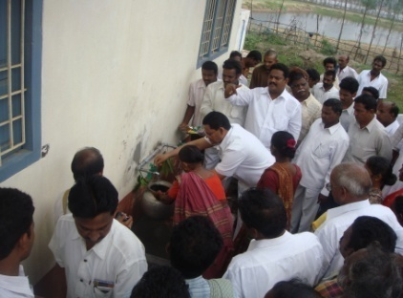
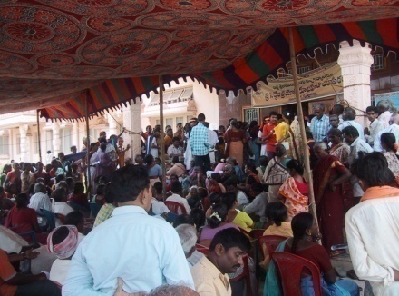
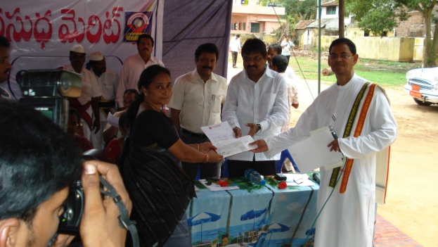
Vasudha Foundation
Services, through its programmes include
* Distribution of note books to the school children
* Distribution of food grains and clothes to the poor people
* Conducting periodic medical camps
* Conducting special medical camps in flood affected areas
* Distribution of clothes, blankets etc to the senior citizens
* Providing financial assistance to the economically
backward students for their studies etc
like s *

Slide 27
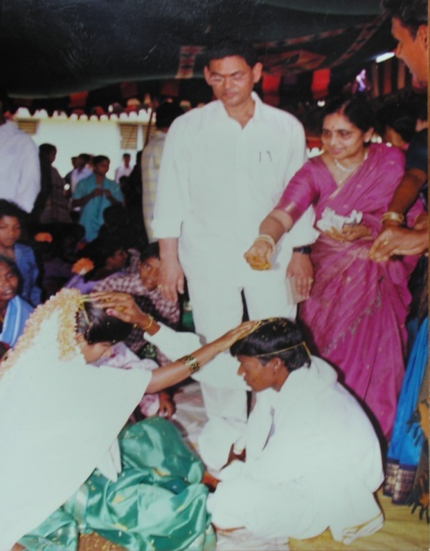
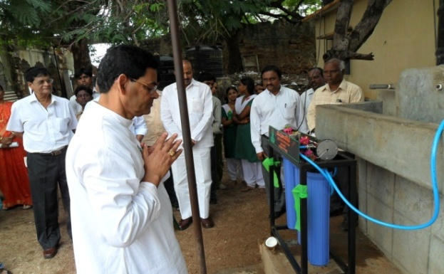
Vasudha Foundation
Also engaged in many other social welfare activities like setting up of RO plants for the purpose of providing clean affordable drinking water for all and always shall be of assistance to needful.
Sarve janah: sukhino bhavanthu
( May every one live happily)

Slide 28
Thank You

